Slide 1

Coffee Chains
Griffin Sykes

Slide 2

Who am I
- Name: Griffin Sykes
- Data Analyst within the Coffee Chains Company
- Goals
Find concrete solutions to profitability issues backed by data
Find solutions to how we can encourage customers to purchase our products
Provide value to both our customers and our business

Slide 3

Background
- What we want to solve
Profitability Issues within our Chains
- Possible Underlying Reasons
How we are marketing products among region
How we are storing products among region
How we margin our products
How we locate our chains within markets

Slide 4
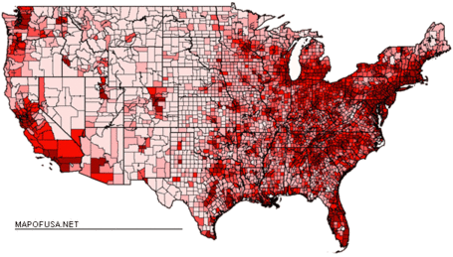
Issue #1
- We are overcompensating to smaller markets
42 small market locations vs. 110 major market locations
More inventory
Smaller profit margins
Over marketing
Higher Total Expenses yet less Sales, different trend from major market

Slide 5
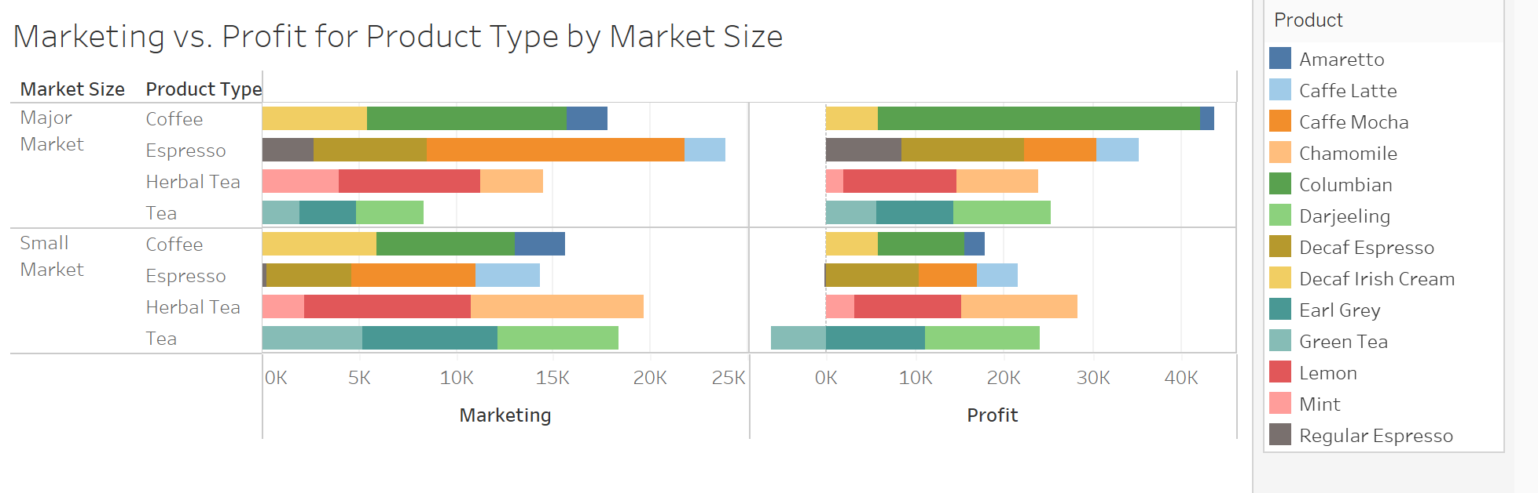
We are analyzing how the company markets each product type. The graph shows the marketing and profit for each product type in both small and major markets. As seen, the Espresso gets a lot of the marketing, yet is outsold by coffee by a lot. This contrasts to small markets, where marketing costs are very similar, yet profit is exponentially less.

Slide 6
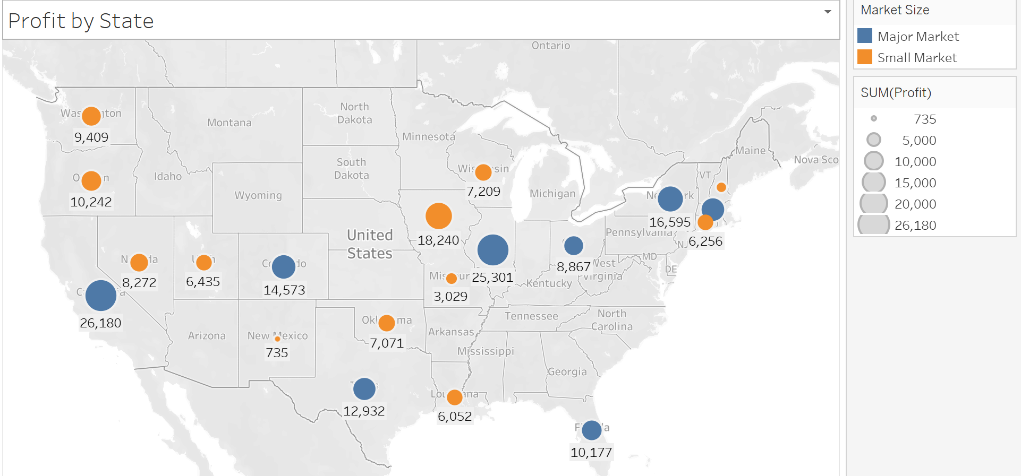
This graph breaks down profit by state, with blue representing major markets and orange representing small markets. This graph shows you how much more major markets bring in from a profit standpoint.

Slide 7
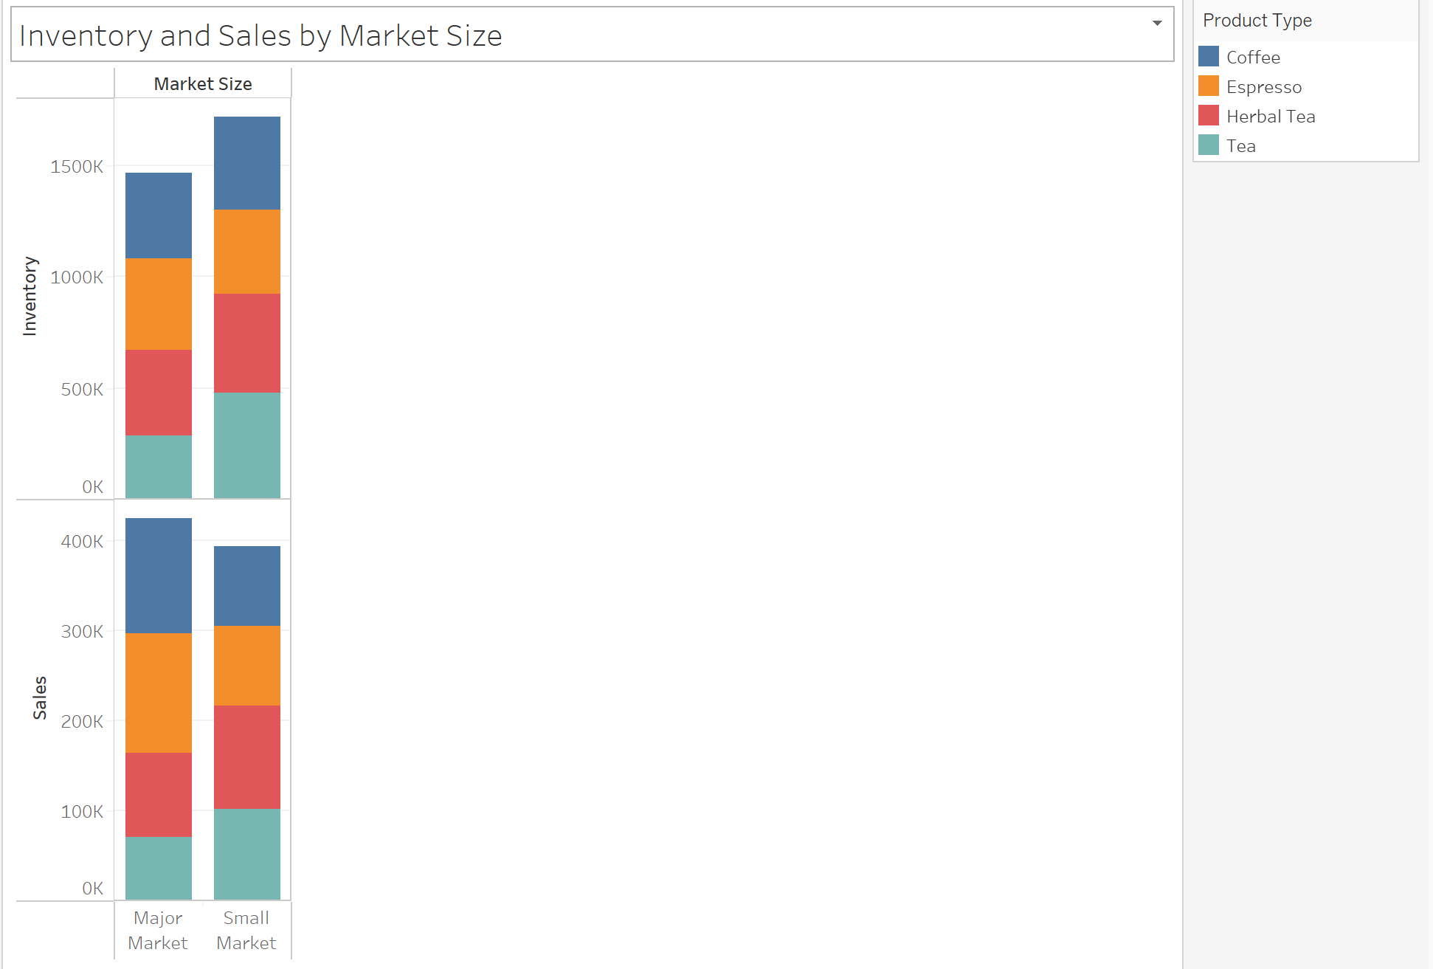
This graph displays inventory and sales by market size. The color represents product type. As seen, even though there are a lot less locations, the inventory for small markets is quite a bit more than the major market. This, however, does not correlate to sales. We are overstocking inventory where it is not necessary.

Slide 8
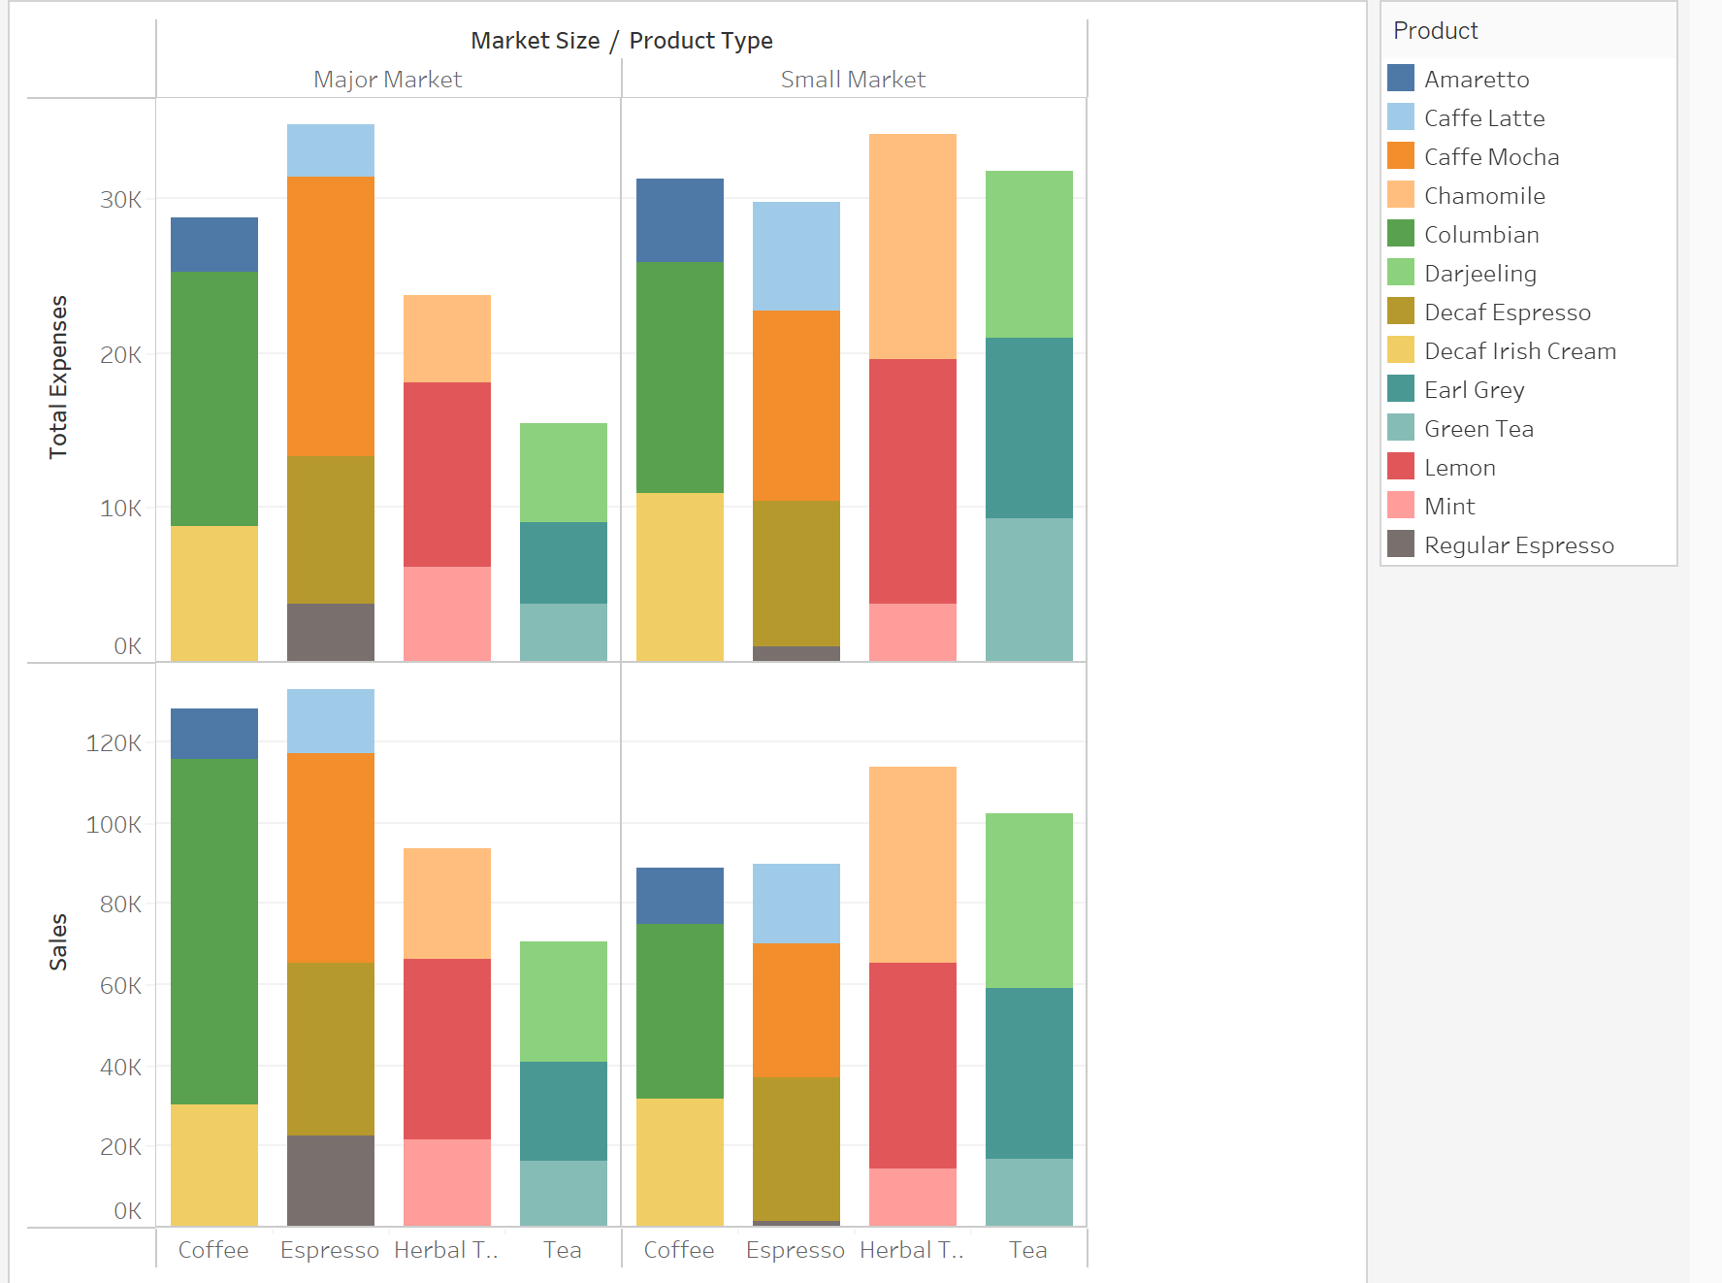
This graph shows total expenses and sales among market size. As seen above, the total expenses in small markets outweigh every product type in the major market in every type except herbal tea. However, the sales are quite a bit less in small markets than major markets.

Slide 9

Recommendations
- Focus on adding locations into Major Markets
- Lower Marketing costs for smaller locations that produce smaller profits
- Find ways to lower expenses for smaller markets
- Lower inventory in smaller markets
- Stop selling Green Tea in small market locations

Slide 10

Issue #2
- Products are underperforming
- Marketing Costs are high for some of the least selling products
- Not optimizing the way, we hold and market our products

Slide 11
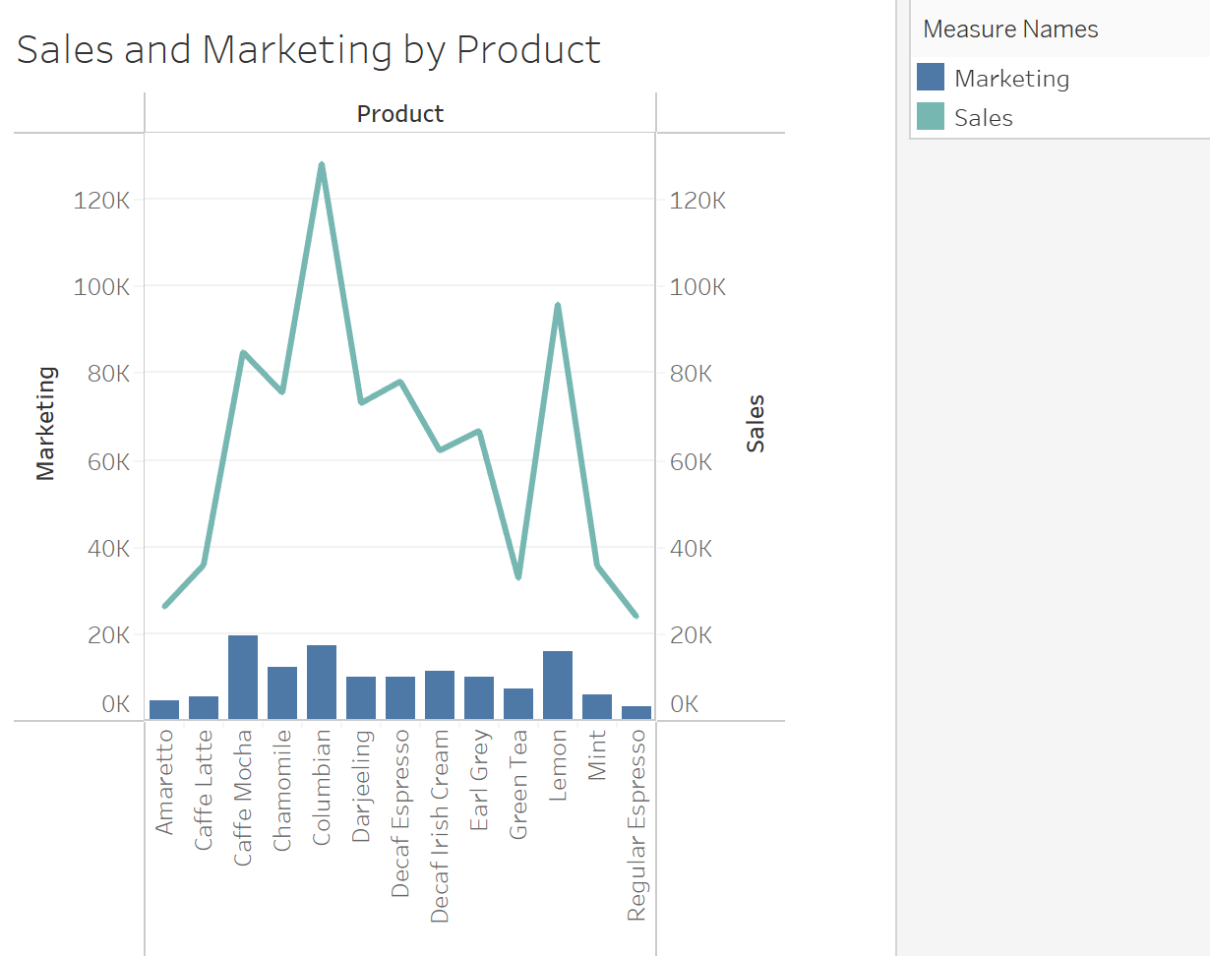
This graph displays the sales and marketing based on each product. This graph shows how high marketing costs are for Caffe Mocha, yet it is clearly outsold by Columbian coffee. Additionally, there similar marketing costs per product yet there are some products that clearly outsell others.

Slide 12
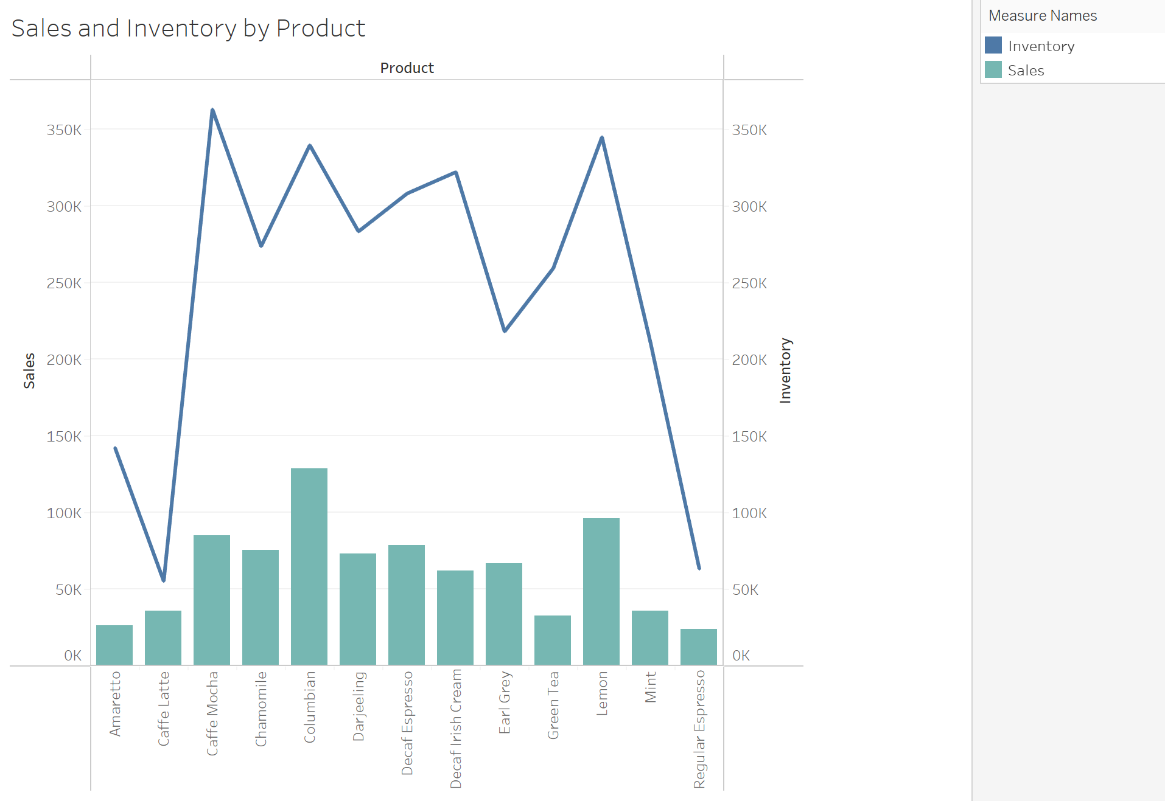
This graph displays the sales and inventory by each product. The Inventory fluctuates highly even though most products, besides Columbian, have similar sales. Although this might be due to price differences between products, it is alarming that we are not catering our inventory to what the customers want the most.

Slide 13
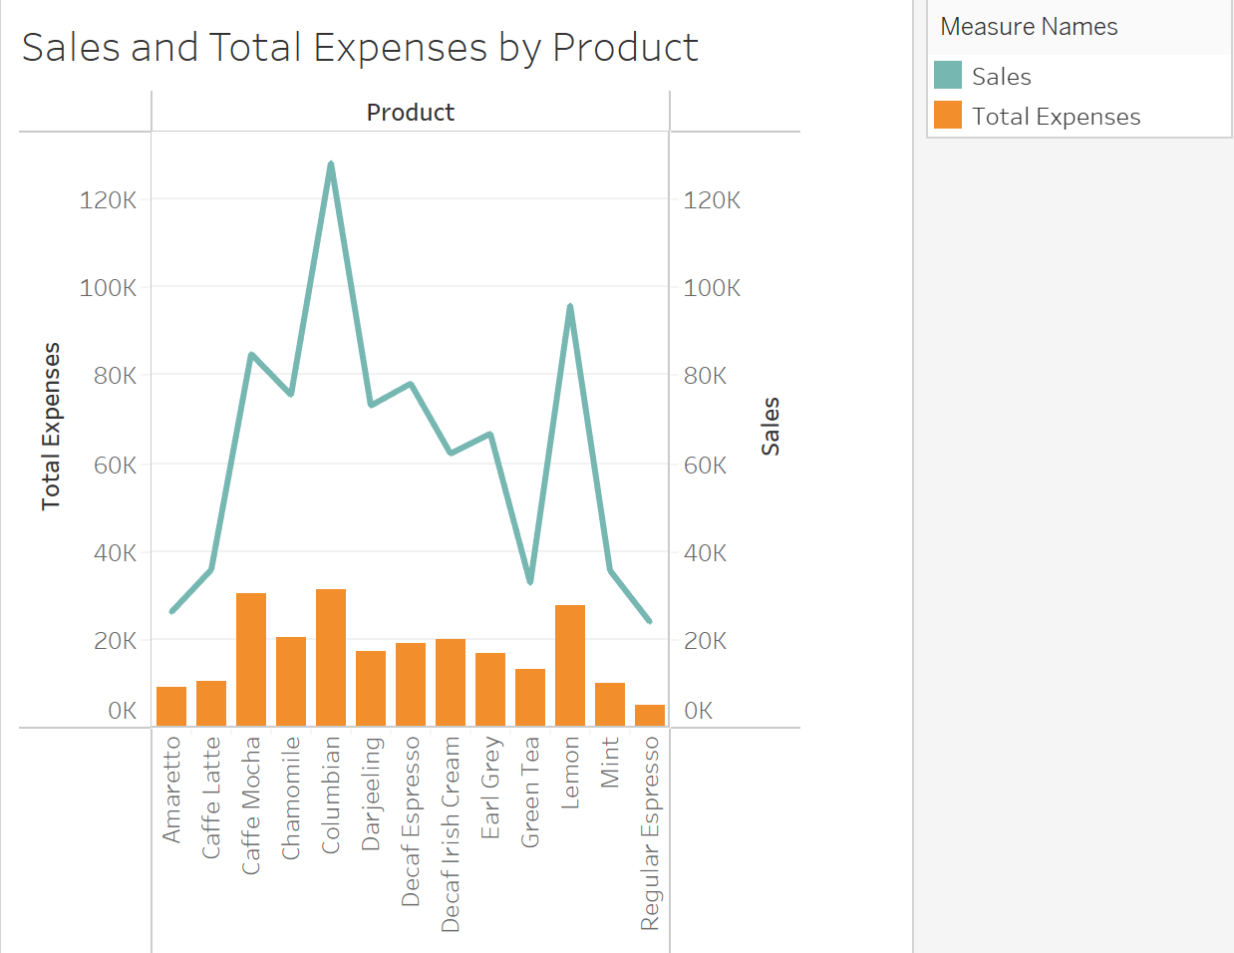
This graph displays the sales and total expenses by each product. This graph displays some of the lack lust products that cost yet don’t sell, such as Amaretto and Green Tea. These products do not help improve the profitability of our company.

Slide 14
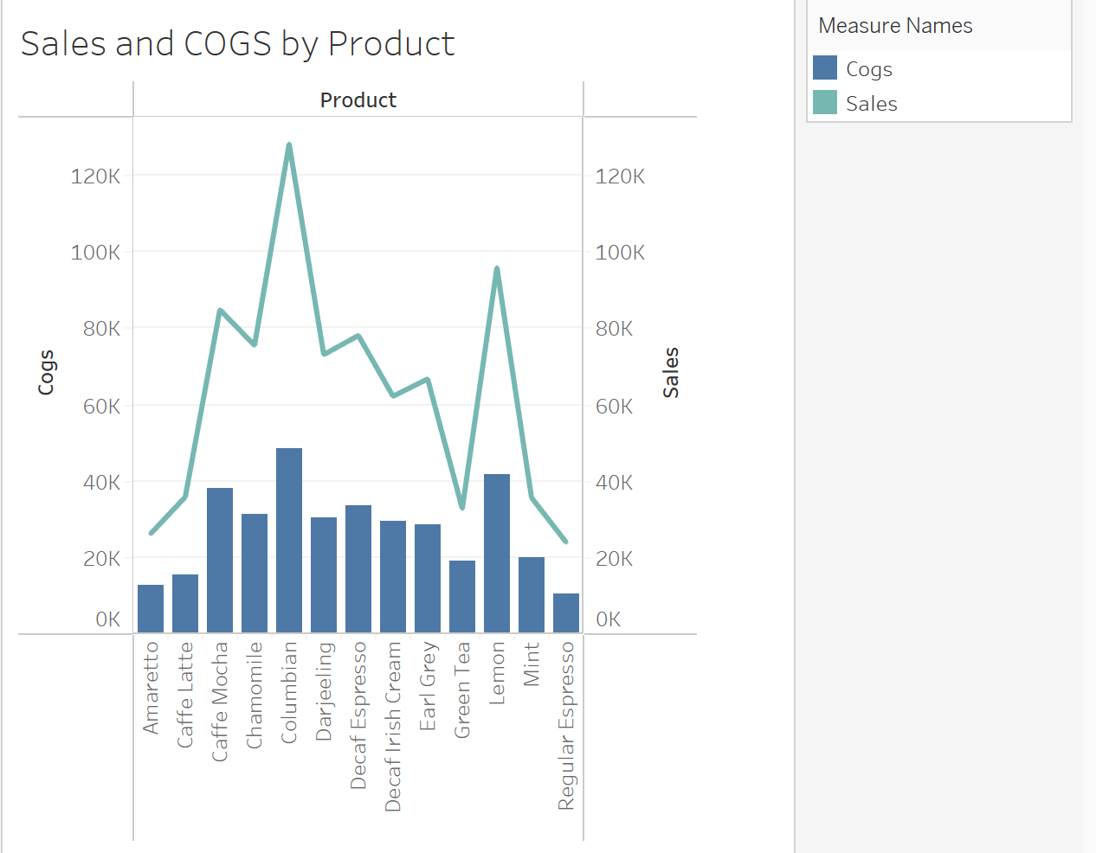

Slide 15

Recommendations
- Utilize data to optimize our products for profitability
- Bulk order best sellers to cut down on total expenses
- Track sales on a month by month basis to gain better insight into trends

Slide 16

Conclusion
- Utilize Data to improve efficiency and profitability among business operations
- Even though we are profitable, we can always improve it
- There are simple changes that can be made to improve profitability
Optimize marketing for best selling products
Optimize inventory based on market size and product
Add more locations in major markets

